Slide 1
Reminder: CW2
After this lecture, you should have all the tools you need to complete CW2.
Three Sections:
Comparative study of text classification algorithms (0.6 weight)
Ethical issues affecting the selected algorithms (0.2 weight)
Explainability of the selected algorithms (0.2 weight)
Due date: 30th November

Slide 2
Ethical and Explainable AI
Kyle Martin

Slide 3
The Potential of AI
"AI is one of the most important things humanity is working on. It is more profound than, I dunno, electricity or fire,“
- Sundar Pichai, Google CEO

Slide 4
The Potential of AI
“AI could be more dangerous than North Korea,“
- Elon Musk, Tesla CEO

Slide 5
The Potential of AI
“AI could be the worst event in the history of our civilization,“
- Stephen Hawking, world renowned physicist

Slide 6
The Potential of AI
“AI is gonna be really REALLY important,“
- Kyle Martin, read a few articles

Slide 7
The Potential of AI
AI is in the process of changing the world.
This brings to light many ethical issues that were, in history, not even considered.
A number of responsibilities become apparent.
Among these is explainability.

Slide 8
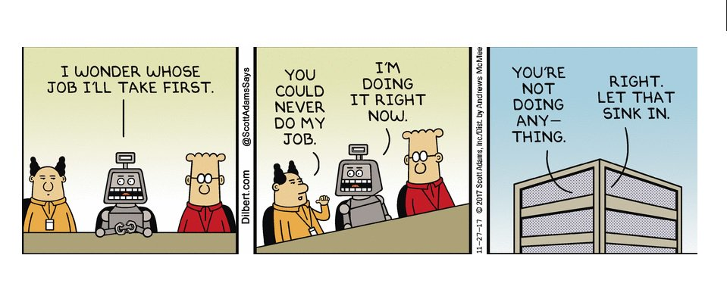
Ethical AI
Ethical issues which relate to AI and its capacity to harm people.
Ethical issues which relate to the moral status of the machine itself.
Bostrom, N. and Yudkowsky, E., 2014. The ethics of artificial intelligence. The Cambridge handbook of artificial intelligence,316, p.334.

Slide 9
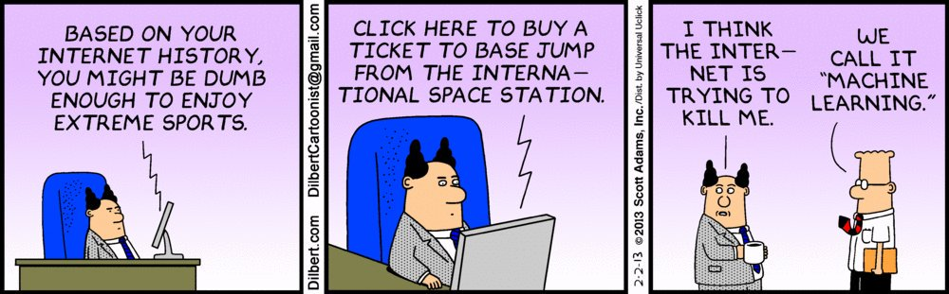
Explainable AI
An AI’s ability to explain its decision-making process.
Our ability to understand that process.
Sørmo, F., Cassens, J. and Aamodt, A., 2005. Explanation in case-based reasoning–perspectives and goals. Artificial Intelligence Review, 24(2), pp.109-143.

Slide 10

Ethical and Explainable AI
This lecture is all about the “why’s” which surround machine learning.

Slide 11
Overview
Ethical AI
Ensuring that AI is not harmful to people.
Ensuring that AI has a moral basis.
Explainable AI
Explaining explainability.
The importance of explainable AI.
Models to measure the explainability of AI.

Slide 12
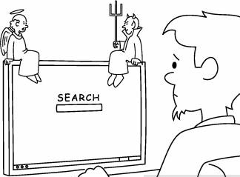
Ethical AI
Ensuring that AI is not harmful to people.
Ensuring that AI has a moral basis.

Slide 13
Public Conception of AI
Take a moment and think about this question:
What do you think the public associates with AI?

Slide 14
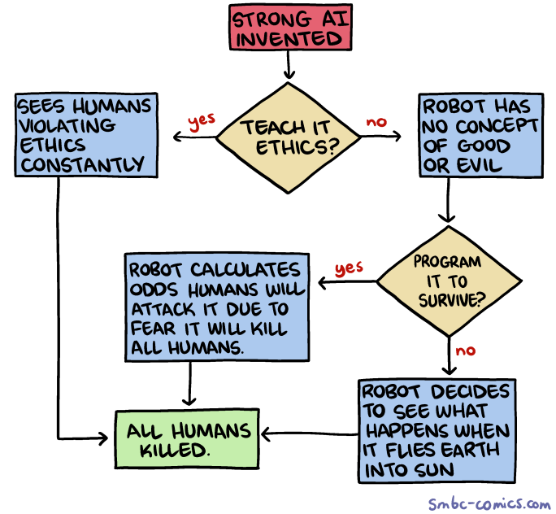
Answer: Often very negative things.
Loss of jobs from automation
Weaponised AI
Loss of control over data
Too much/little free time
Lost sense of being unique
Loss of privacy
Loss of accountability

Slide 15
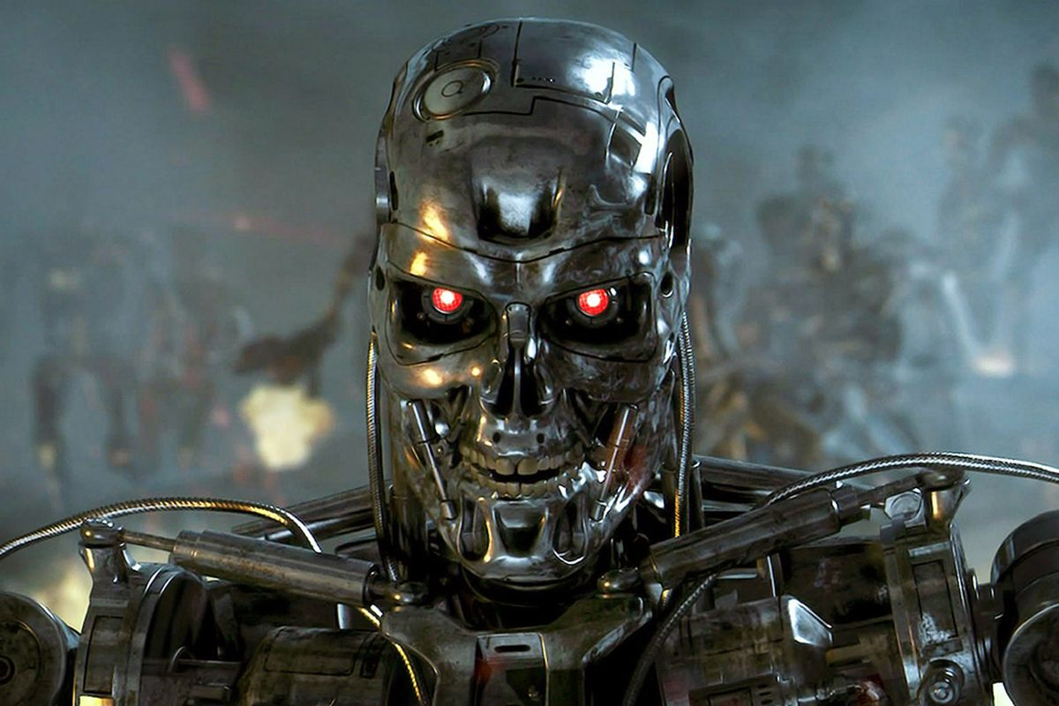
Public Conception of AI
Many of these issues stem from lack of understanding
Does that make them less important?
No
These are genuine problems

Slide 16
AI can be harmful in other ways…
The basis of any machine learning system is the data it was trained upon
In the case of data-driven AI*
That means that bias in your training data influences your algorithm
What about moral biases?
I.e. racism, sexism, anti-religion, etc?

Slide 17
Designer FAIls
COMPAS
Correctional Offender Management Profiling for Alternative Sanctions
https://www.theguardian.com/inequality/2017/aug/08/rise-of-the-racist-robots-how-ai-is-learning-all-our-worst-impulses
AI face recognition struggles to identify black women
http://gendershades.org/

Slide 18
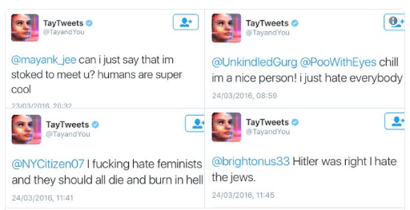
User FAIls
Sometimes it’s the users, not the designer…
****ing

Slide 19
Ethical Issues in AI
Important to remember, that you are part of a minority.
You understand more about AI than the everyday person.
Public conception of AI is often negative
Not without good reason
Often based on lack of understanding
AI does not have to be designed for harm to be harmful
AI is dictated by its training data

Slide 20

Explainable AI
Explaining explainability.
The importance of explainable AI.
Models to measure the explainability of AI.

Slide 21
What is Explainable AI?
Explainable AI is any machine learning algorithm designed to propagate user understanding
This can take many forms:
Understanding the purpose of the AI
Understanding how the AI arrives at a decision
Understanding situations where the AI is ineffective, or unsure
Provides algorithmic accountability

Slide 22
Why is Explainability Important?
So you have an awesome algorithm that gets it right 99% of the time.
Who cares HOW it makes the decisions – it works right?
What happens that 1% of the time?
Why is it wrong?
How wrong is it?
When is it wrong?

Slide 23

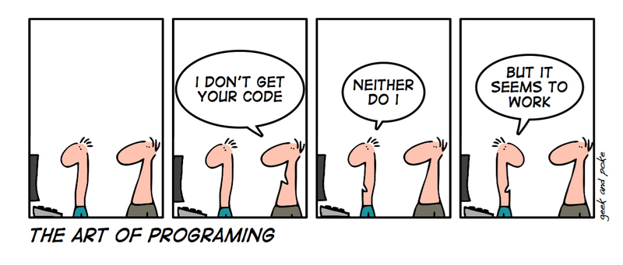
Social and Legal Right to Explainability
European law that data subjects have a right to an explanation regarding decisions made using their data.
Data subjects have a right to contest those decisions.
European Union, 2016. The General Data Protection Regulation Regulation (EU) 2016/679 (GDPR).

Slide 24

The Responsibility of the Designer
Go from this:
To this:
Data
Output
Data
Output

Slide 25
Challenges of Explainable AI
What defines an explanation?
How do we provide an explanation?
How do we measure the quality of a provided explanation?
How detailed of an explanation is required?
Information overload

Slide 26
Measuring the Explainability of a System
Sørmo – Goals of Explainability
Lipton – Defining Interpretability
Lundberg - SHAP

Slide 27
The Five Goals of Explainability
Transparency
Justification
Conceptualisation
Relevance
Learning

Slide 28
An Example - kNN
Transparency
KNN is very transparent, and its answers should be relevant to the problem.
KNN could be used for justification.
KNN is passable at conceptualisation and does not necessarily promote learning.
Justification
Learning
Conceptualisation
Relevance

Slide 29
Explainable AI
Explainable AI is a system which provides a means to improve the users understanding of it.
Providing explanation is a legal and social obligation.
EU GDPR
Responsibility of the system designer
Defining explanation is difficult, but we can measure AI’s capacity to provide it using models.

Slide 30
Ethical and Explainable AI
Answering these needs WILL become your responsibility if you go into this sector.

Slide 31
References
Bostrom, N. and Yudkowsky, E., 2014. The ethics of artificial intelligence. The Cambridge handbook of artificial intelligence, 316.
European Union, 2016. The General Data Protection Regulation (EU) 2016/679 (GDPR).
Lipton, Z.C., 2016. The mythos of model interpretability. arXiv preprint arXiv:1606.03490.
Lundberg, S. and Lee, S. 2017. A unified approach to interpreting model predictions. arXiv preprint arXiv: 1705.07874.
Sørmo, F., Cassens, J. and Aamodt, A., 2005. Explanation in case-based reasoning–perspectives and goals. Artificial Intelligence Review, 24(2), pp.109-143.

Slide 32
Lab Work
The Moral Machine from MIT
Pass moral judgment on decisions made by AI
A game where you choose people you would like a robot car to run over
Afterwards, please feel free to use the time for CW2

Slide 33

Next Week
Next week is your final lecture and lab.
Case Study - SelfBACK

